Slide 1
Local voices
Penny Johnston
www.pennyjohnston.org
Working In collaboration with
Cork Folklore Project
Béaloideas/Folklore & Ethnology
Digital Arts & Humanities
University College Cork
Image © J. Sunderland/Cork Folklore Project

Slide 2
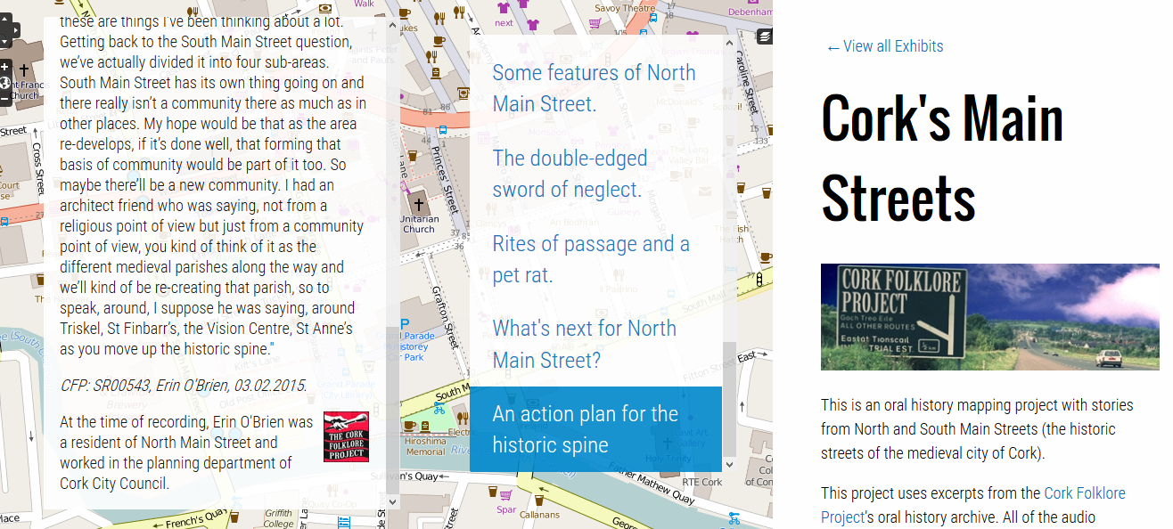
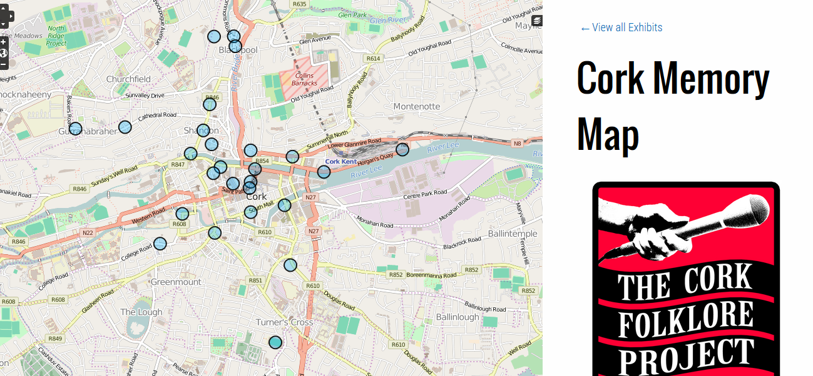
1
1: Original Cork Memory Map http://www.ucc.ie/research/memorymap/
2
2: North & South Main Streets http://pennyjohnston.org/exhibits/neatline/show/north-and-south-main-streets#records/42 accessed 29 August 2016
3
3: New Cork Memory Map http://storiesofplace.org/neatline/show/stories-of-place accessed 29 August 2016

Slide 3
